Slide 1
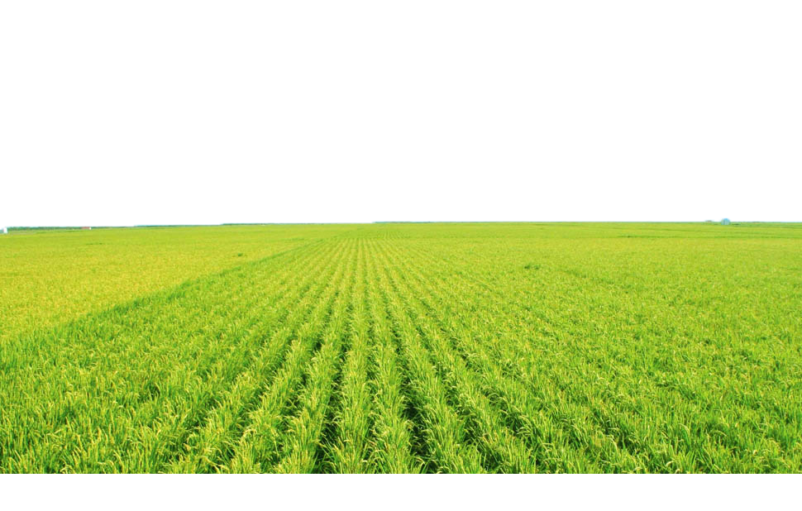
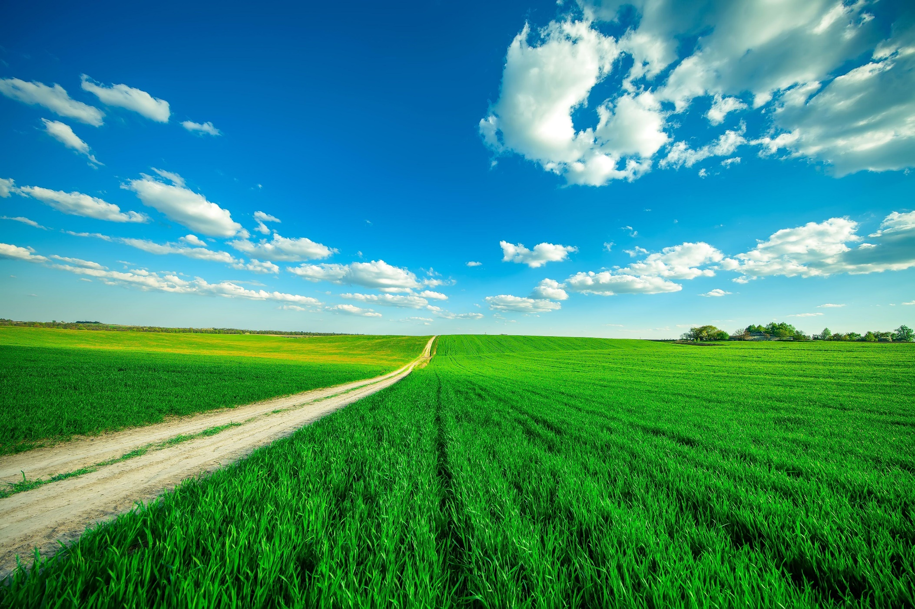



E-KETHA : ENRICHING RICE FARMER’S QUALITY OF LIFE THROUGH A MOBILE APPLICCATION
2022-81

Slide 2




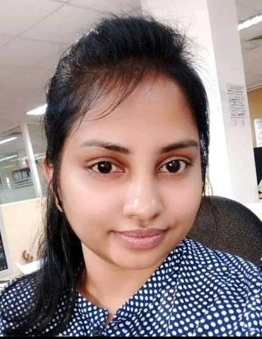

Meet The Team
Salika Madhushanka W.J
Group Leader
P.Y.D Jayasinghe Member 02
H.H.W.M.Binuka Sihan Paranagama Member 03
K.M.Umesh Ranthilina
Member 04
Ms. Amali Upeka Gunasinghe
Co-Supervisor
Mr. Adeepa Gunarathna Supervisor

Slide 3
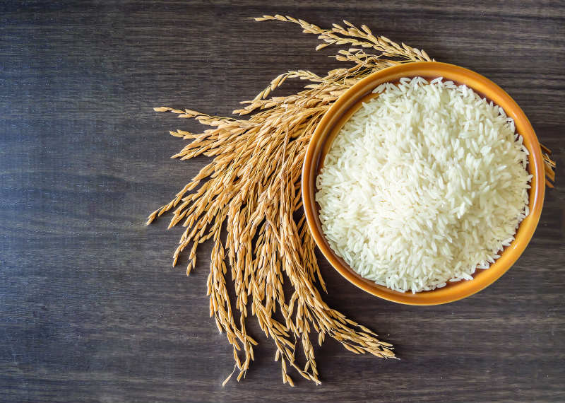
Introduction
To Improve livelihood farmers by helping them when it comes to
Diseases & pests,
Weeds
Growth
Fertilizer management

Slide 4

Mobile Application

Slide 5
Research Questions
What sort of algorithm best fit a mobile application so that for the farmer get best user experience

Slide 6
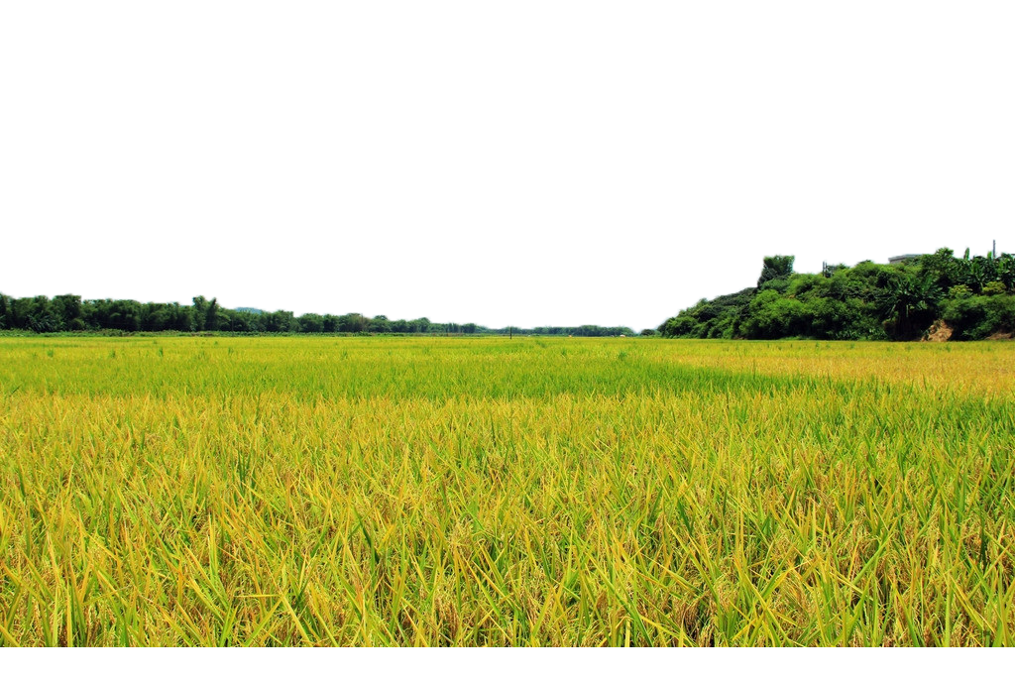
Main Objective
Enhancing farmers livelihood

Slide 7
Sub objectives
Fertilizer Management
Identify Pests, Diseases then provide solutions
Identify Weeds and then provide solutions
Growth deficiency and then provide solutions

Slide 8
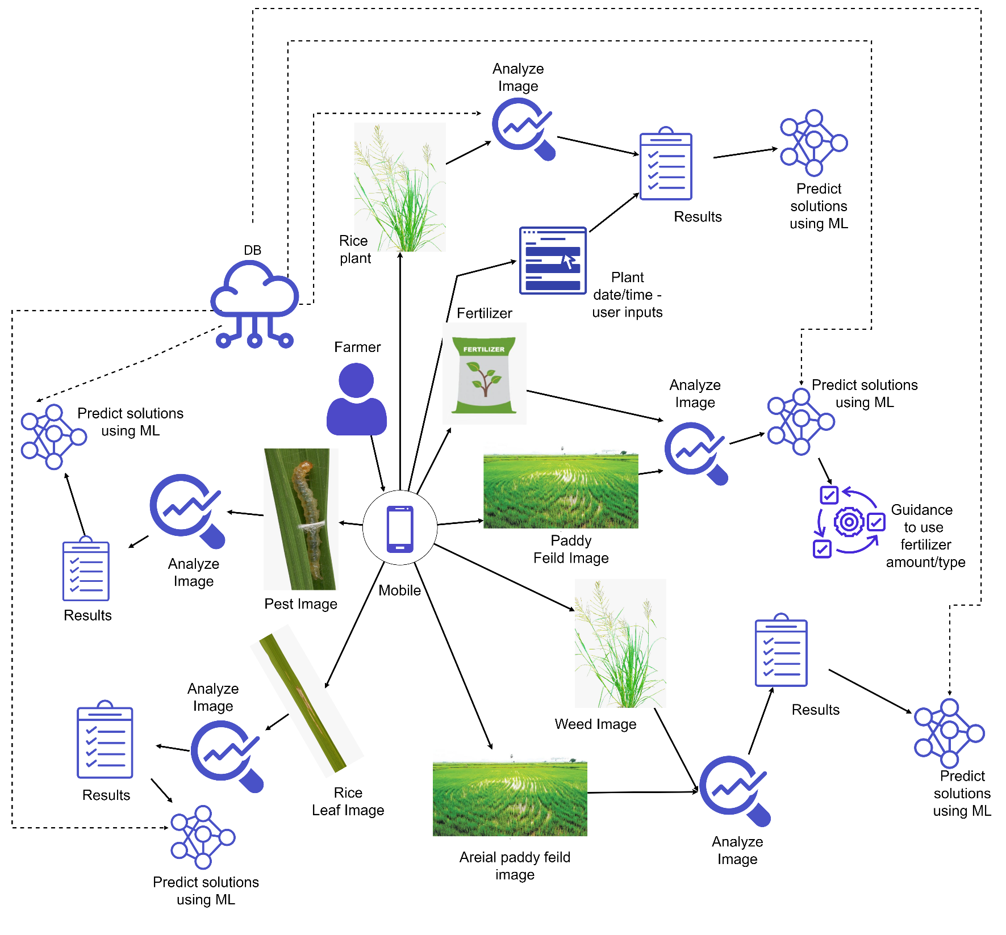
Overall System Diagram

Slide 9

IT19101620 | Salika Madhushanka W.J
Software Engineering
IT19101620 | Salika Madhushanka W.J | 2022-81

Slide 10
Research Question
How to get a proper output from the application
How to Best fit that model into a mobile application
How to find the best algorithm for pest and disease identifications

Slide 11

Objectives Achieved
Use of Deep learning neural network to train and identify pests and diseases
Mobile application integrated with the chosen model
Creating a fully functional mobile application with the integrated model

Slide 12
Requirements
Functional requirements
Identify the pests and diseases using images.
Providing the disease and pest type.
Providing solutions for those diseases and pests.
Non-functional requirements
Availability
Accuracy
Speed

Slide 13
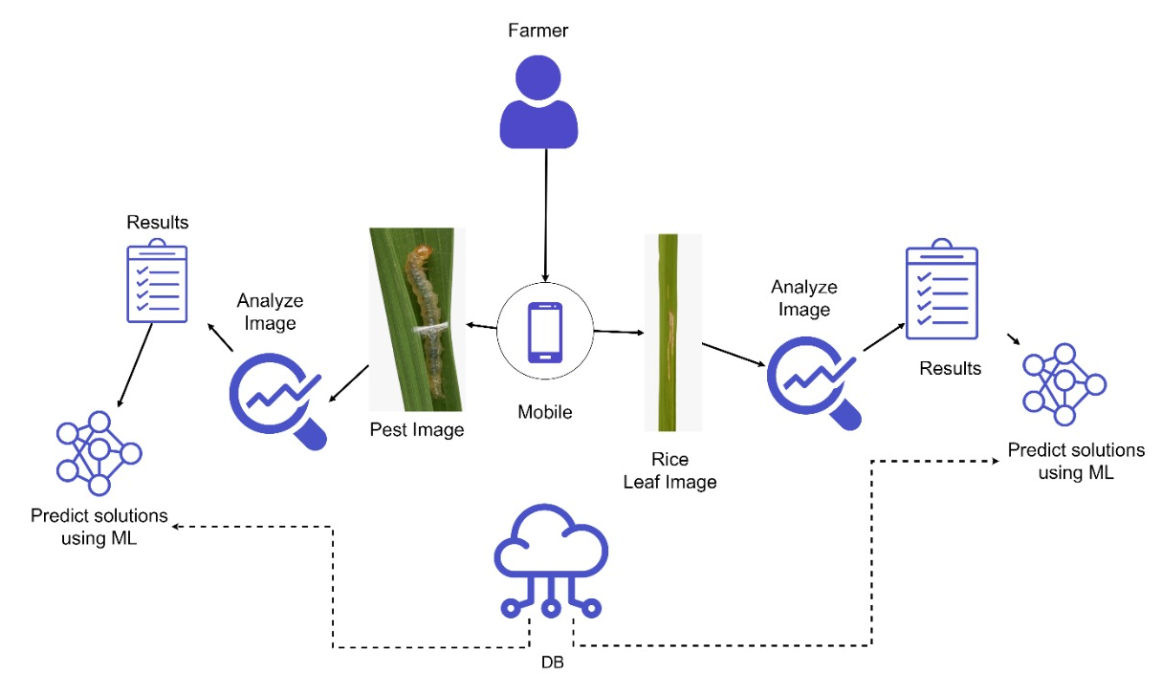
Methodology
System Overview Diagram

Slide 14
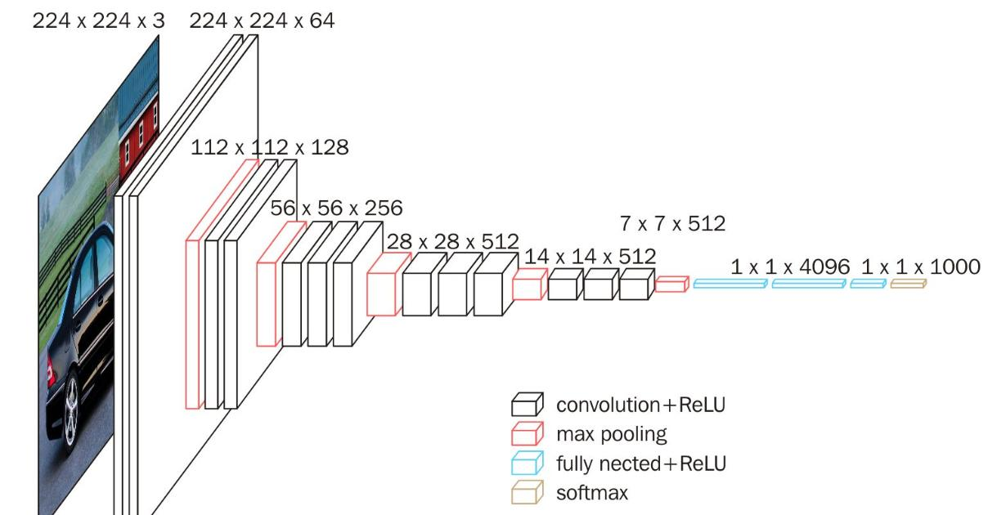


Methodology Cont...
Used technologies
Diseases Identification Model
CNN Architecture
Tools and Frameworks
Keras - Tensorflow
Pest measurement Model
AlexNet Architecture
IDE
Jupyter Notebook.

Slide 15
Diseases Detection
Model | Avg training time per epoch | Accuracy | Loss | Val_accuracy | Resource consumption (RAM)
ResNet50 | 3m 46s | 0.9298 | 0.0351 | 0.9237 | 9.31
Custom CNN model | 3m 03s | 0.9469 | 0.1720 | 0.9563 | 6.19
Model Comparison

Slide 16
Pests Detection
Model | Avg training time per epoch | Accuracy | Loss | Val_accuracy | Resource consumption (RAM)
AlexNet | 2m | 0.7837 | 0.2875 | 0.7775 | 9.31
Custom CNN model | 1m 33s | 0.8042 | 0.1053 | 0.6619 | 6.19
Model Comparison

Slide 17
Final Progress

Slide 18
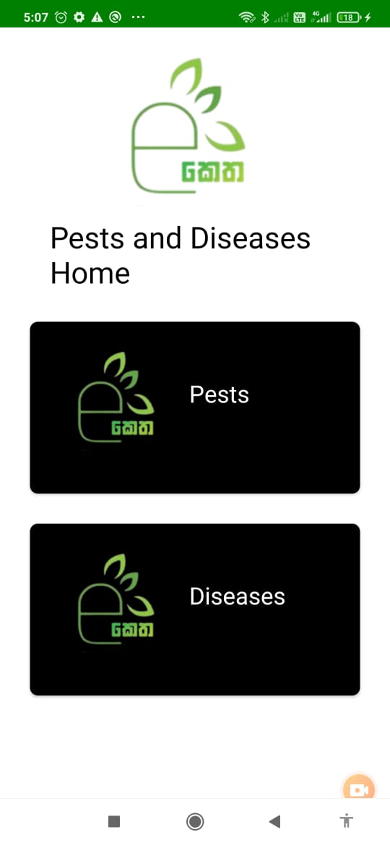
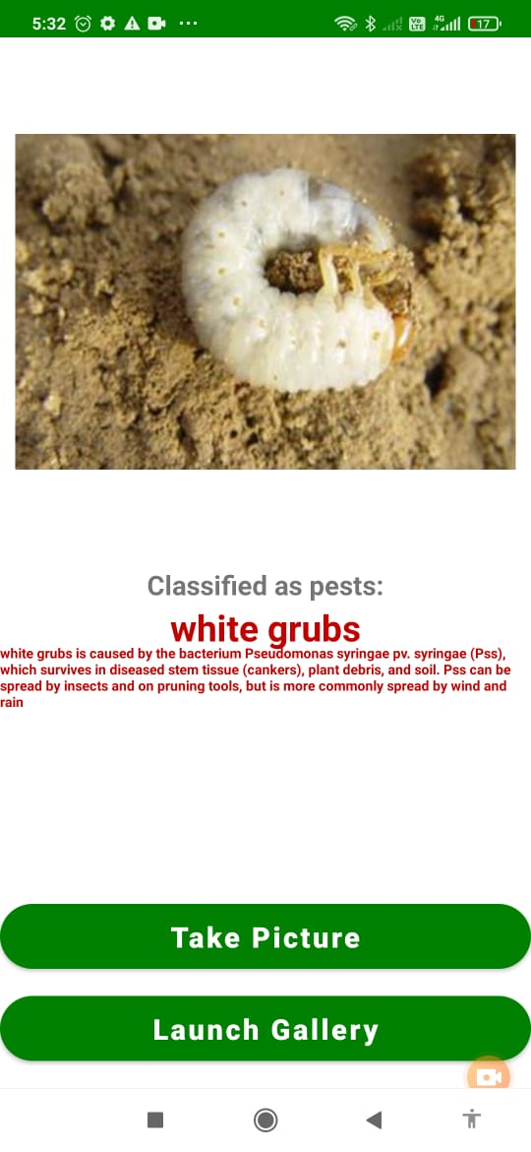
Pests' identification
Pests

Slide 19
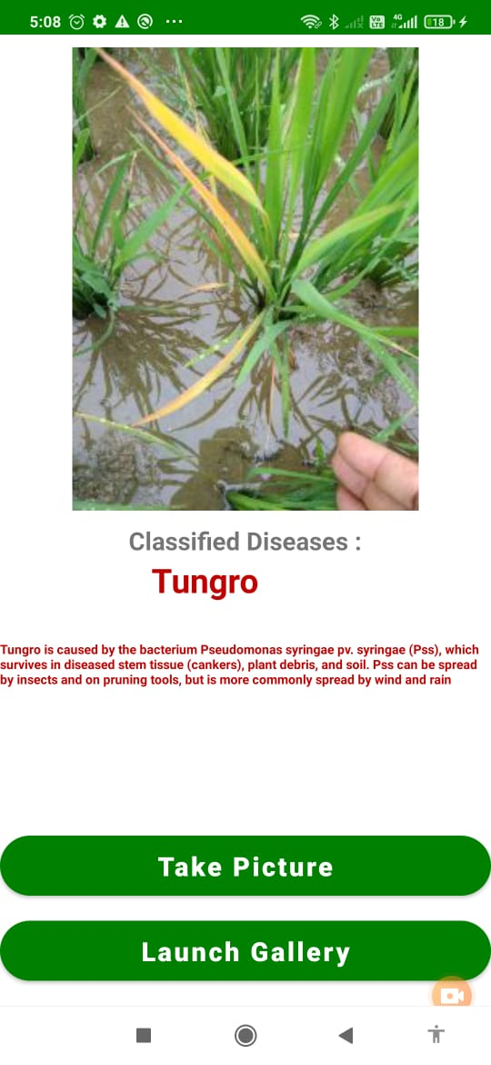
Diseases identification
Disease

Slide 20
Demonstration

Slide 21

IT19117256 | P.Y.D Jayasinghe
Software Engineering
IT19117256 | P.Y.D Jayasinghe | 2022-81

Slide 22
Research Question
How to Best fit that model into a mobile application
How to find the best algorithm for weed mapping areas in paddy fields
How to find the best algorithm for Weeds identification
How to get a proper output from the application

Slide 23
Objectives Achieved
Use of Deep learning neural network to train and identify weeds
Usage of semantic segmentation for weed mapping
Mobile application integrated with the chosen model
Creating a fully functional mobile application with the integrated model

Slide 24
Specific and Sub Objectives
Specific Objectives
Identify weed areas.
Identify weed type.
Sub Objectives
Find weed data set for mapping and detection.
Mapping weeds through aerial imagery given to the mobile app.
Detecting weeds and their type through an image given to the mobile app.
Defining models for both identification and mapping of weeds.
Configuring the model so that it can be used from the mobile app.
Providing solutions for weeds

Slide 25
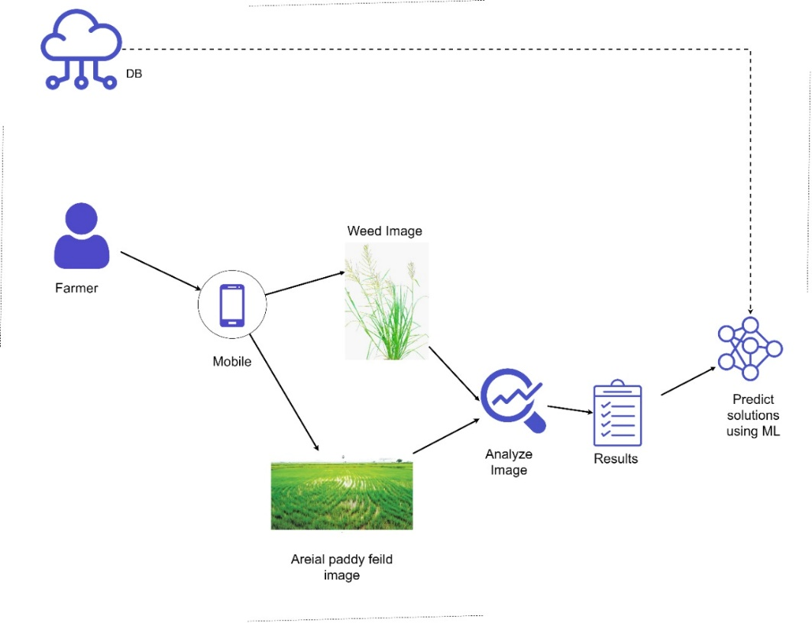
Methodology
System Overview Diagram

Slide 26

Methodology Cont...
Used technologies
Weed Identification Model
Resnet50 – CNN model
Semantic Segmentation Model
FCNN
IDE
Google Colab/ Jupyter Notebook.

Slide 27
Weed Detection
Model | Avg training time per epoch | Accuracy | Loss | Val_accuracy | Resource consumption (RAM)
ResNet50 | 8m 33s | 9.7 | 0.35 | 0.70 | 9.31
Custom CNN model | 5m 20s | 9.7 | 0.07 | 0.69 | 6.19
Model Comparison

Slide 28
Weed Mapping
Model | Avg training time per epoch | Accuracy | Loss | Val_accuracy | Resource consumption (RAM)
U-Net | 1m 71s | 0.8894 | 0.3205 | 0.6306 | 6.53
Custom CNN model | 1m 66s | 0.8988 | 0.2835 | 0.6450 | 7.96
Model Comparison

Slide 29
Final Progress

Slide 30
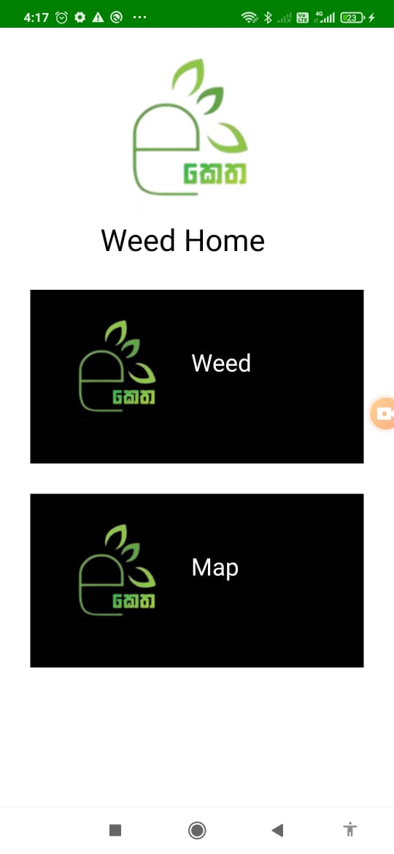
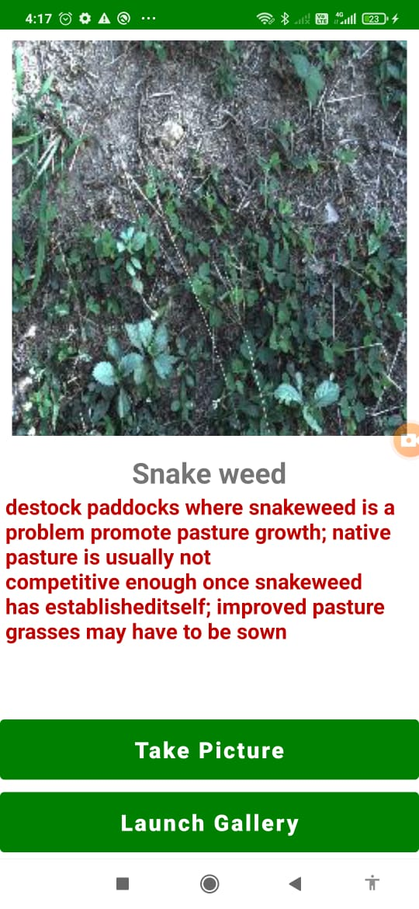
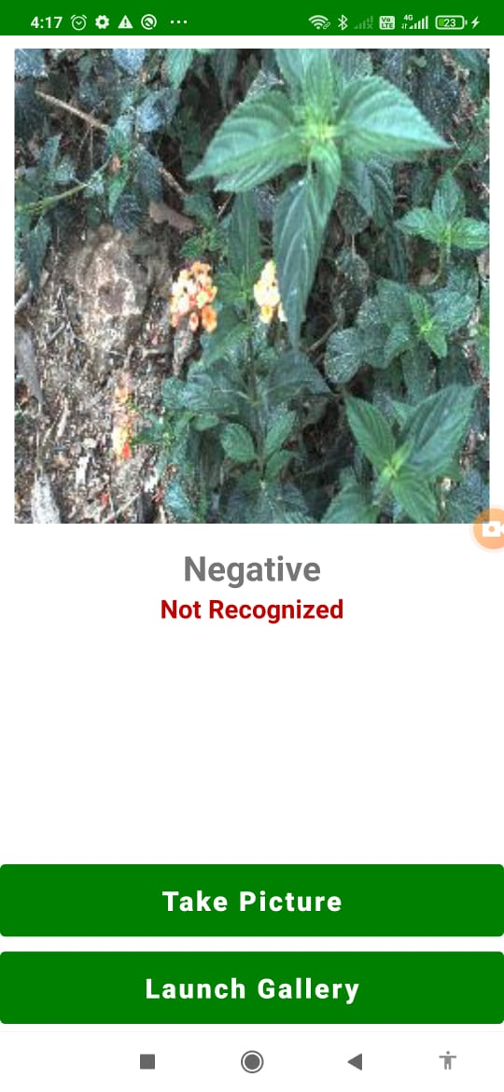
Weed Identification
Weed

Slide 31
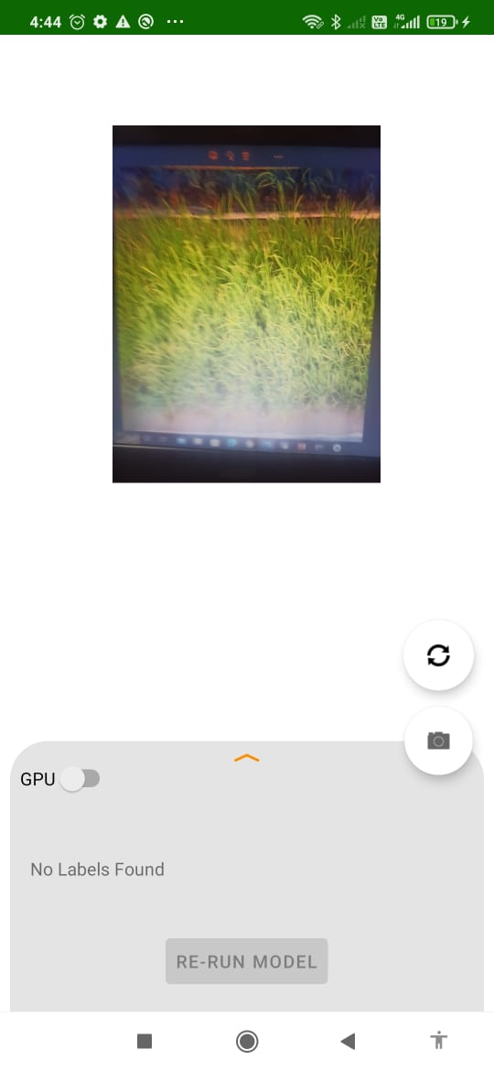
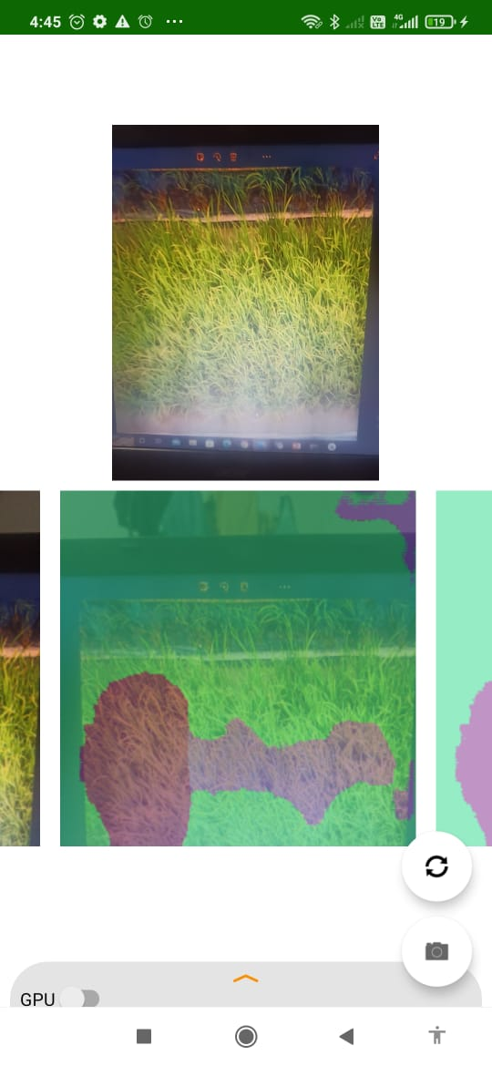
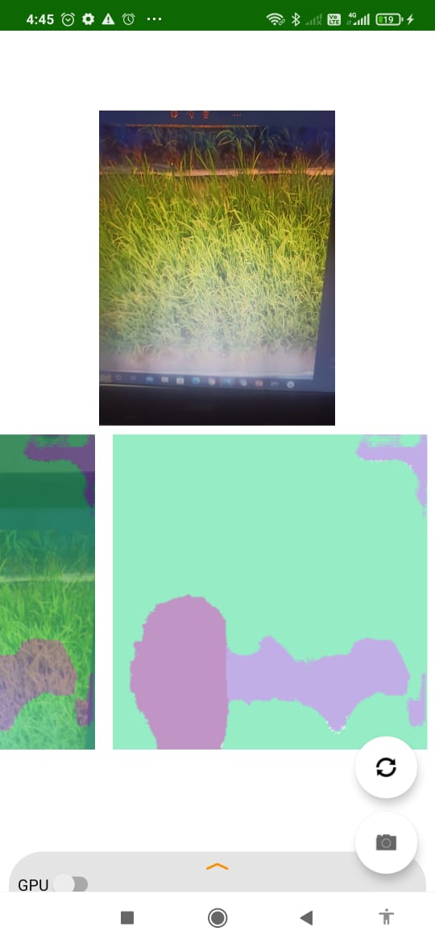
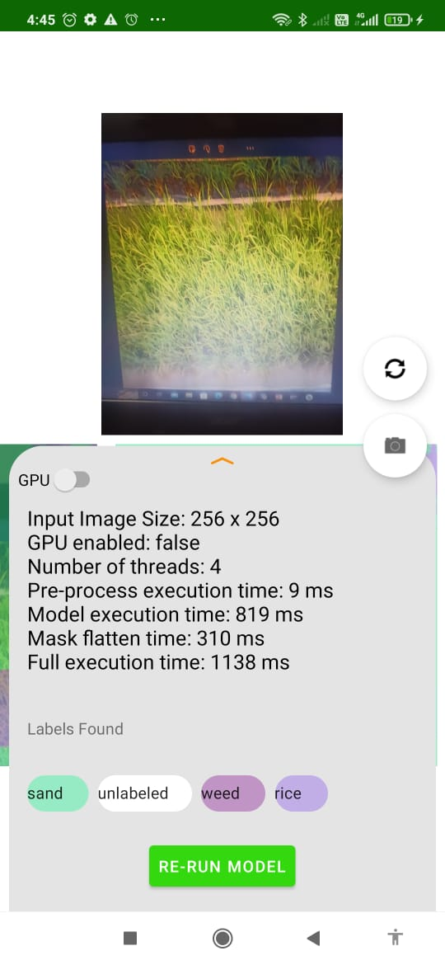
Weed Mapping
Weed

Slide 32
Demonstration

Slide 33

IT19129372 | h.h.w.m.Binuka Sihan paranagamA
Software Engineering
IT19129372 | H.H.W.M.Binuka Sihan Paranagama | 2022-81

Slide 34
Research Question
How to provide guidance on usage of fertilizers?
How to measure the area of the paddy field?
How to find the best algorithm for fertilizer type identification

Slide 35
Objectives Achieved
Use of Deep learning neural network to train and identify fertilizer type
Mobile application integrated with the chosen model
Creating a fully functional mobile application with the integrated model

Slide 36
Requirements
Functional requirements
Identify of Fertilizer type by using images.
Measure the paddy area of the paddy area that needs to be fertilized.
Provide guidance on how to use fertilizers.
Non-functional requirements
Availability
Efficiency
Accuracy

Slide 37
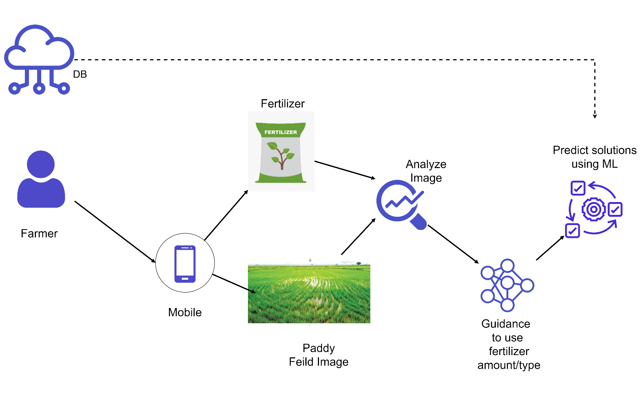
Methodology
System Overview Diagram

Slide 38

Methodology Cont...
Used technologies
Fertilizers Identification Model
CNN model
Tools and Frameworks
Keras - Tensorflow
Area measurement
GPS
IDE
Jupyter Notebook.
Android Studio

Slide 39
Model Discussion
Model | Avg training time per epoch | Accuracy | Loss | Val_accuracy | Resource consumption (RAM)
ResNet50 | 2m 10s | 0.8919 | 0.2444 | 0.8570 | 6.32
Custom CNN model | 48s | 0.9073 | 0.2172 | 0.8750 | 3.29
Model Comparison

Slide 40
Final Progress

Slide 41
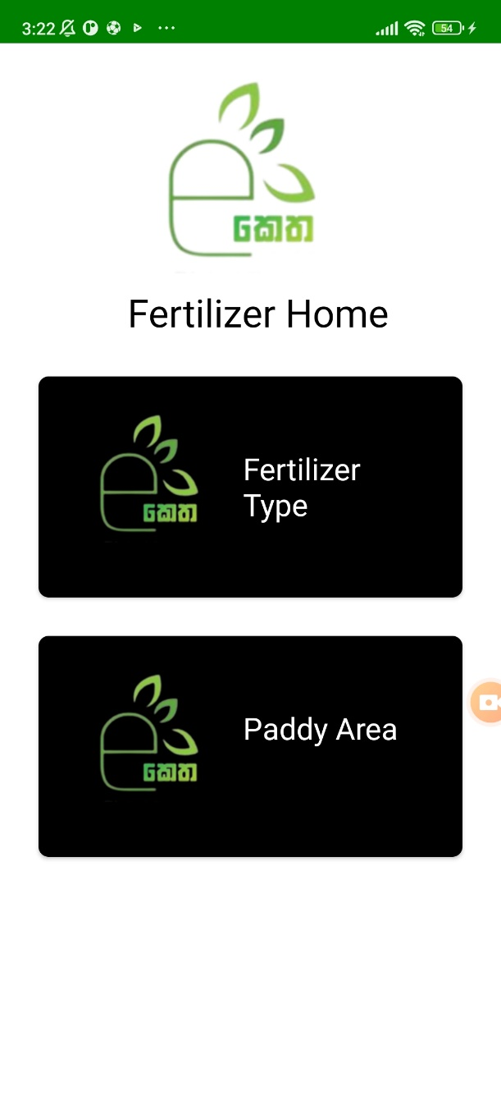
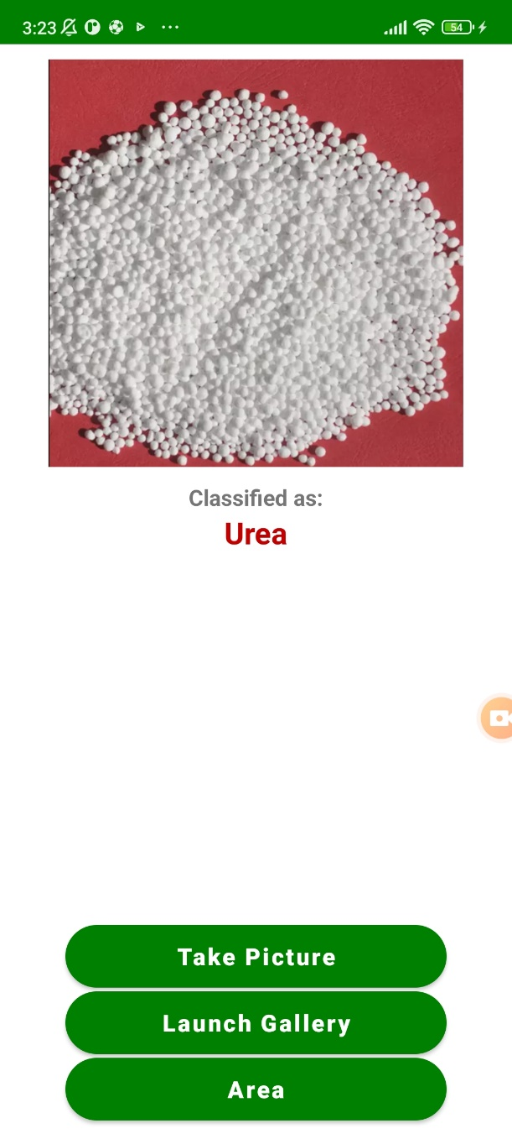
Fertilizer prediction
Predicting the fertilizer type

Slide 42


Paddy Area Calculation
User Input

Slide 43


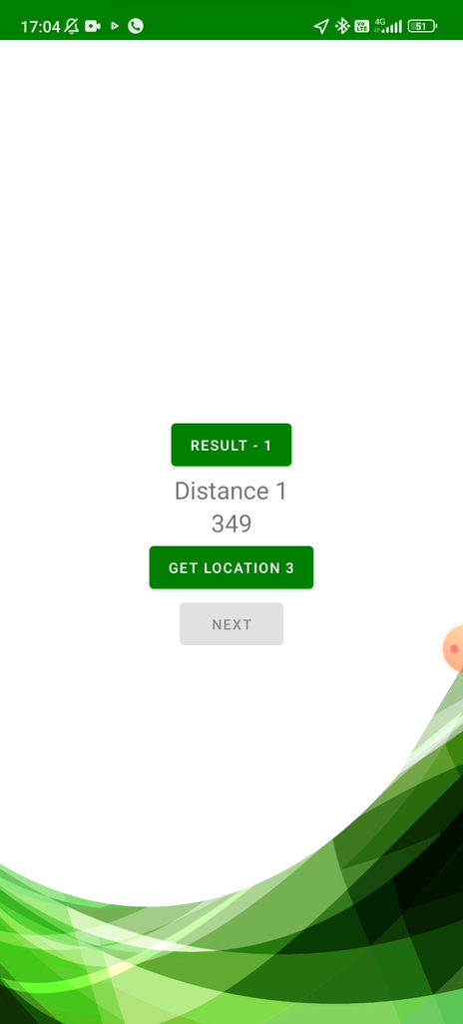

Paddy Area Calculation
Using GPS

Slide 44

Paddy Area Calculation
Using GPS

Slide 45
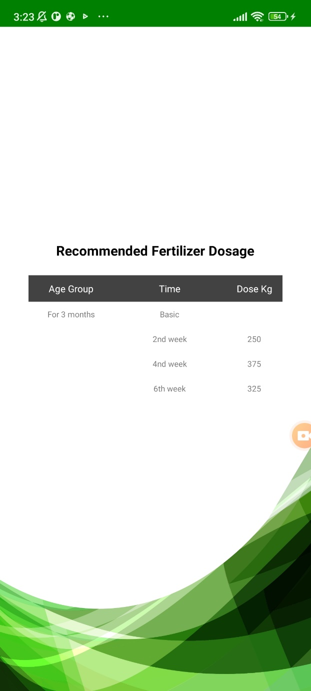
Providing Guidance
Guidance

Slide 46
Demonstration

Slide 47

IT19240152 | K.M.Umesh Ranthilina
Software Engineering
IT19240152 | K.M.Umesh Ranthilina | 2022-81

Slide 48
Research Question
How to identify the growth using the height?
How to provide solutions for deficiencies in growth?
How to measure height of a plant?
How to detect rice plants from other plants?

Slide 49
Objectives Achieved
Use of Deep learning neural network to train and identify rice.
Mobile application integrated with the chosen model
Implement a height measurement function
Creating a fully functional mobile application with the integrated model

Slide 50
Specific and Sub Objectives
Specific Objectives
Identify of Rice plant.
Identify growth and deficiency.
Sub Objectives
Find rice data set for detection.
Detecting rice plants using image to figure out whether it is a rice plant or not through a mobile app.
Defining models for both identification and height measurement.
Configuring the model so that it can be used from the mobile app.
Providing solutions for the deficiency.

Slide 51
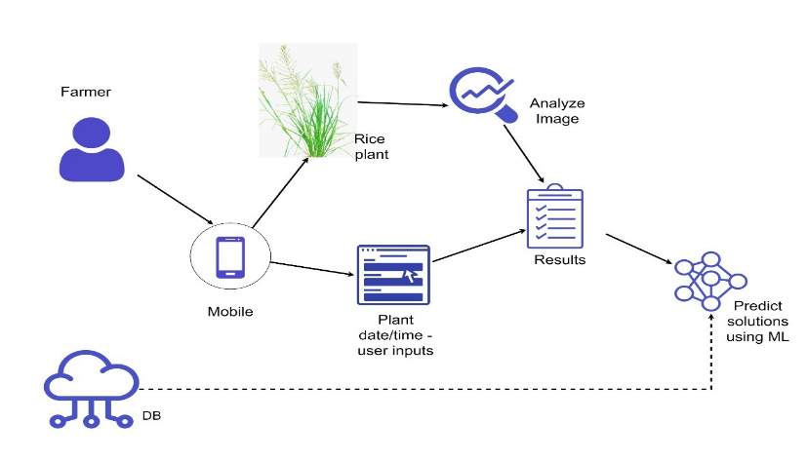
Methodology
System Overview Diagram

Slide 52

Methodology Cont...
Used technologies
Rice Identification Model
AlexNet – CNN model
Height measurement Model
Python - openCV
IDE
Jupyter Notebook.

Slide 53
Model Discussion
Model | Avg training time per epoch | Accuracy | Loss | Val_accuracy | Resource consumption (RAM)
AlexNet | 3m 10s | 0.8639 | 0.3642 | 0.9642 | 7.15
Custom CNN model | 1m 20s | 0.9855 | 0.0428 | 0.9805 | 5.29
Model Comparison

Slide 54
Final Progress

Slide 55
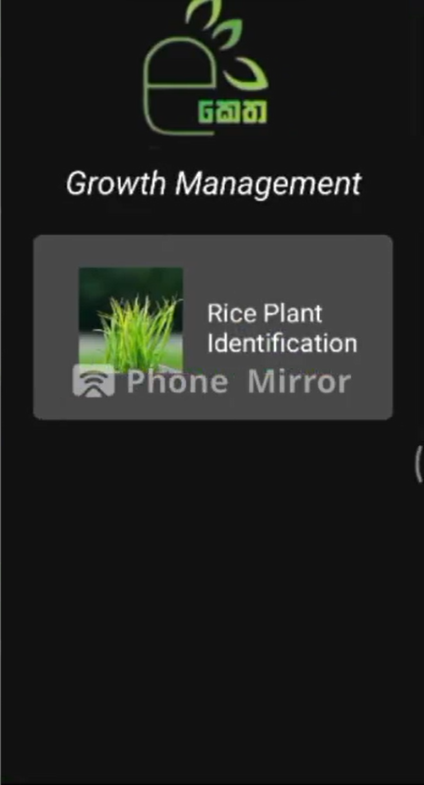
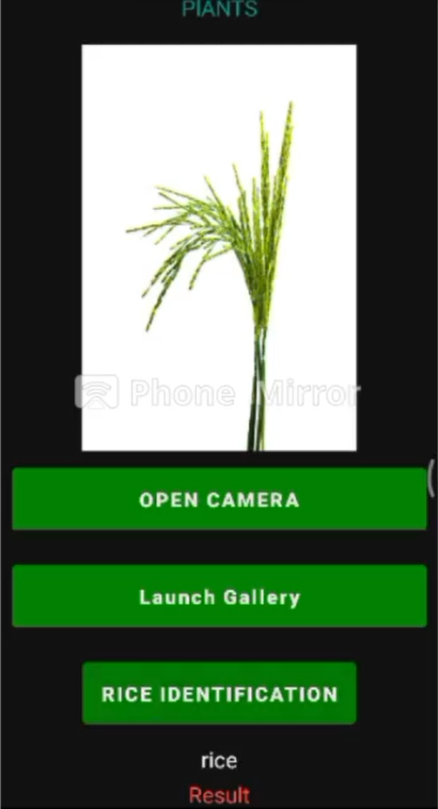
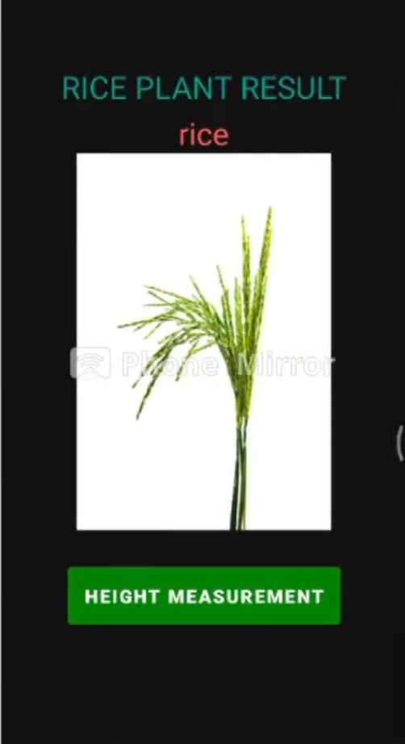
Rice plant identification
Rice Plant

Slide 56
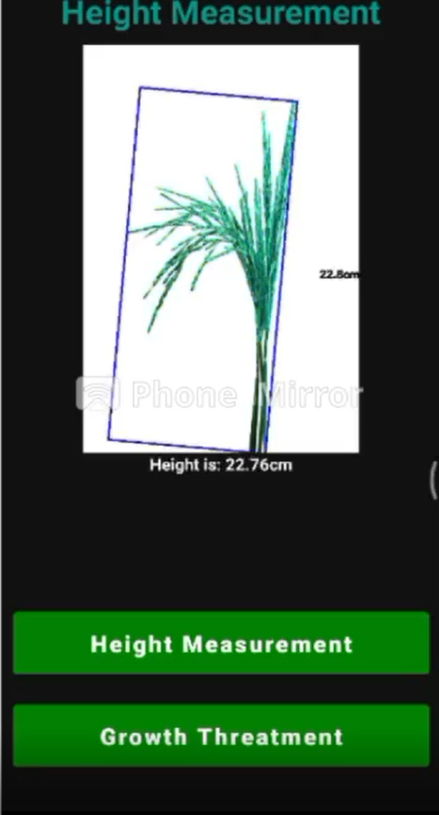
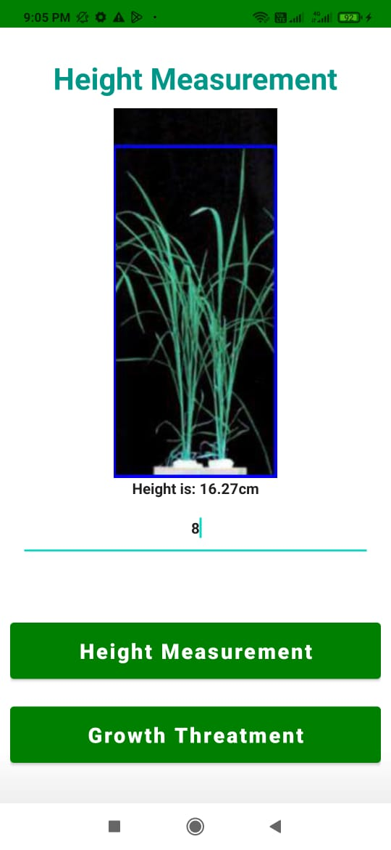
Rice plant height
Height

Slide 57
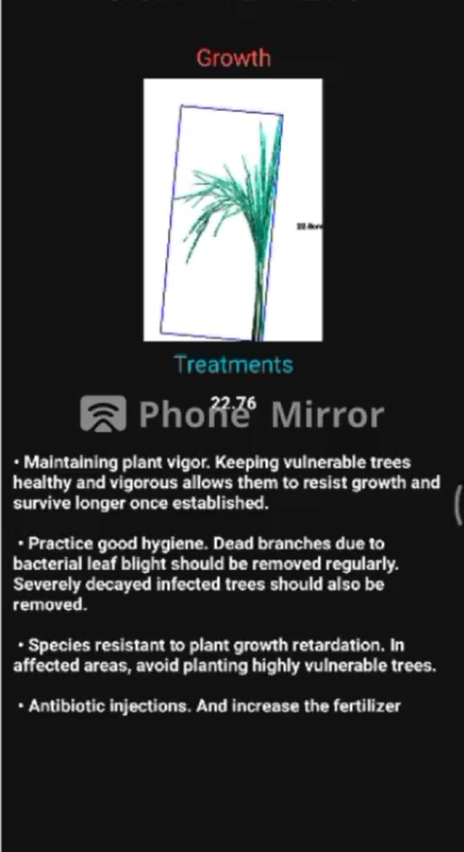
Growth Solutions
Solutions

Slide 58
Demonstration

Slide 59
Marketing Commercialization Plan
Target Customers
Farmers
Advertising and Communication
Advertise on social media
Creating customer packages
Free – With third-party Advertisement
Paid – Advertisement free
Recognizing target farmers

Slide 60
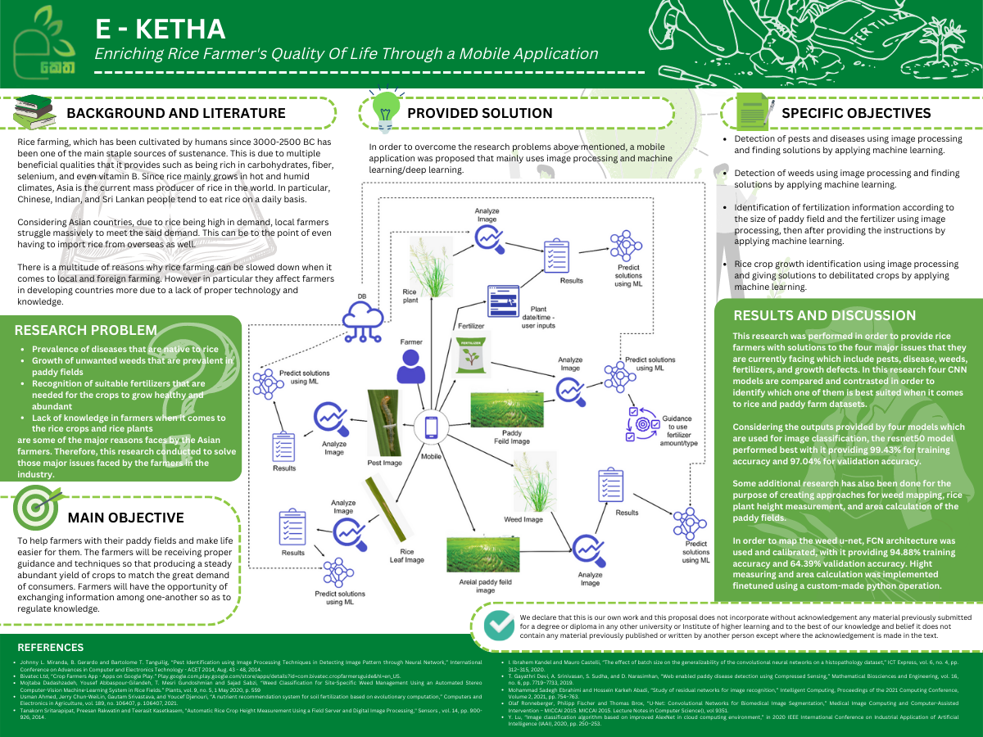
Poster

Slide 61
THANK YOU

